Slide 1
THRIVING
TOGETHER
Nurturing Our Team
at Nature Canada
May 2024

Slide 2
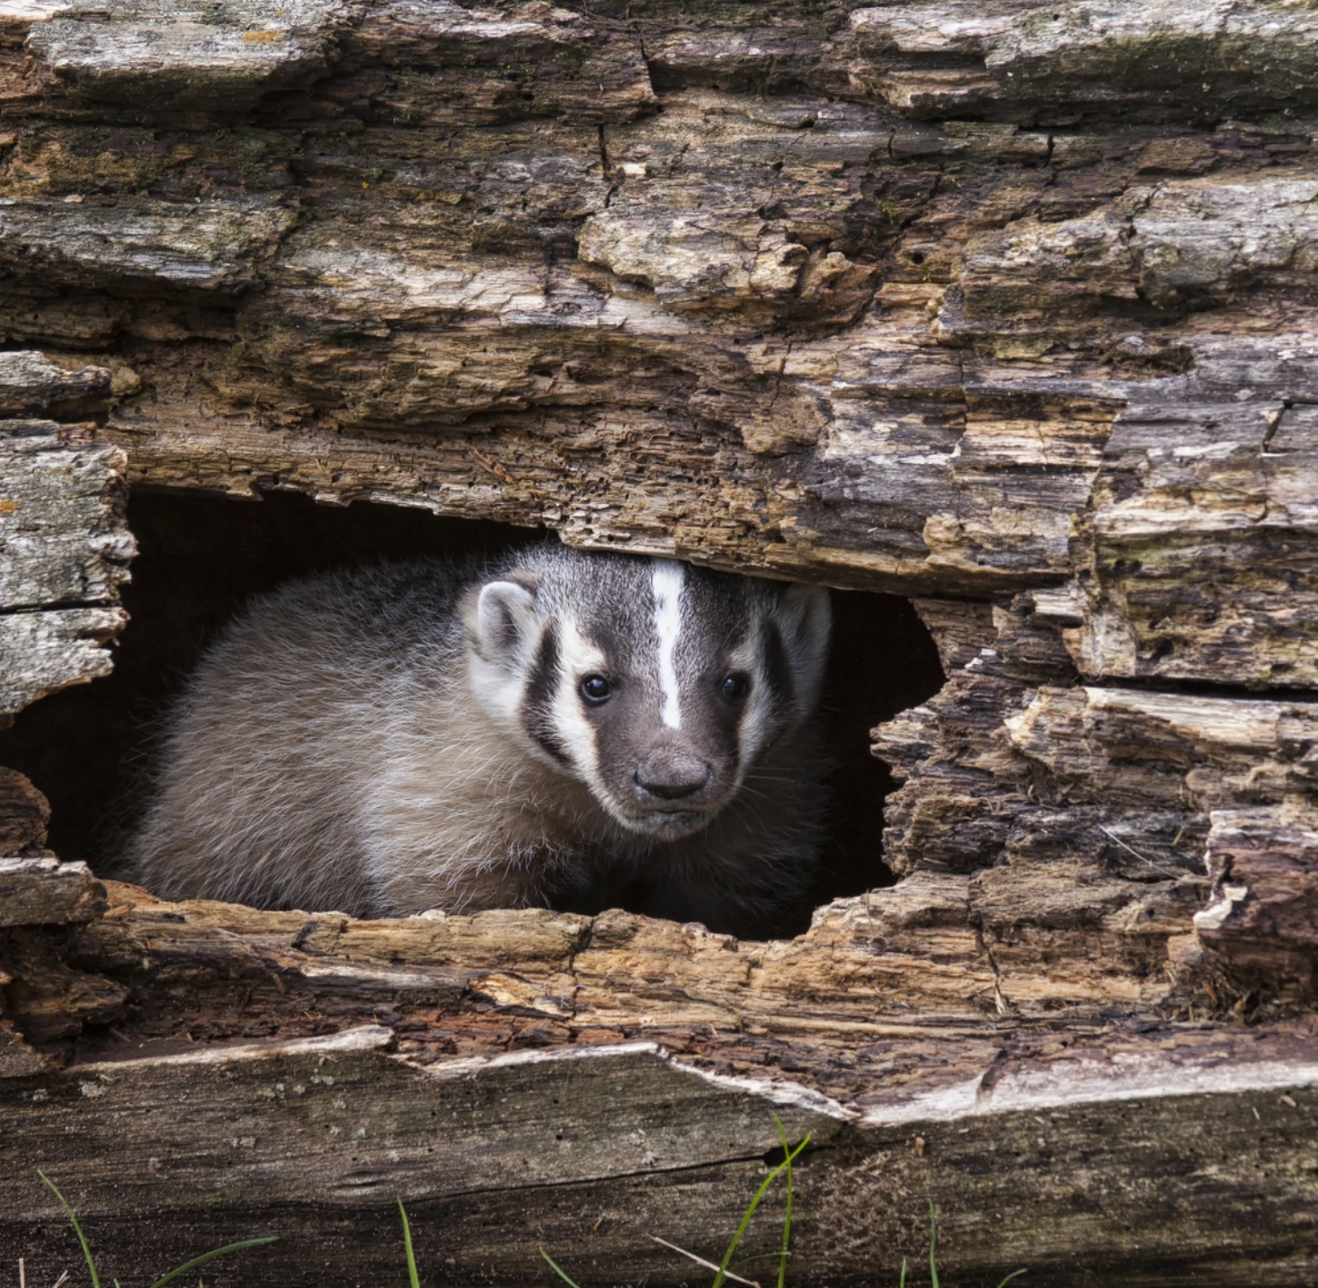
Rooted in Success:
Fostering our Team’s Potential
We are the bedrock of our success!
When someone leaves, we lose:
Skills
Relationships
Knowledge
Time
Thriving Together: Nurturing Our Team at Nature Canada

Slide 3
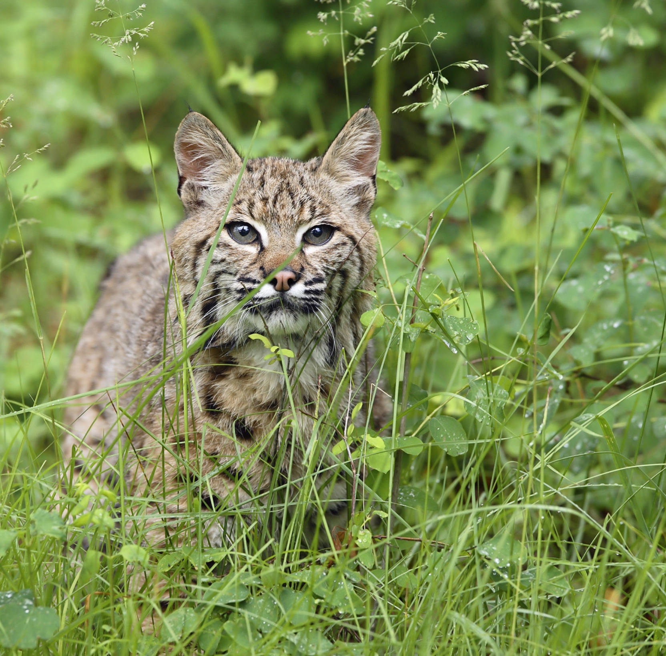
Goal:
Be an Employer of Choice
Thriving Together: Nurturing Our Team at Nature Canada

Slide 4
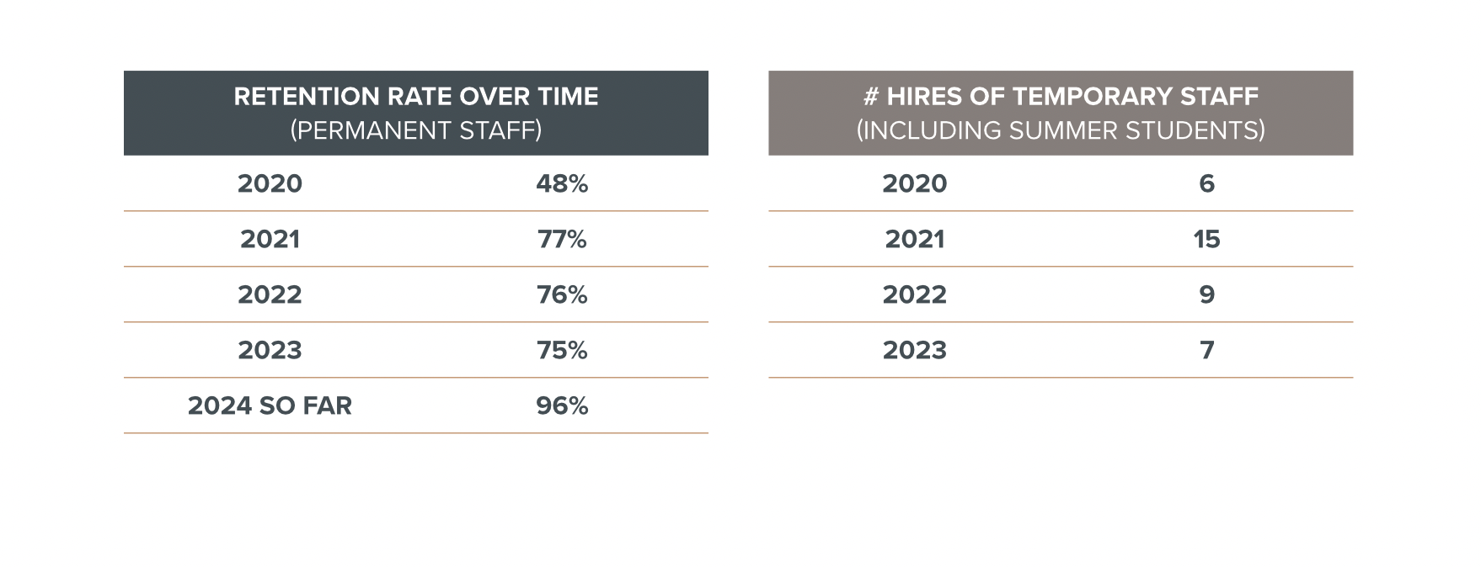
Tracking Our Team's Stability and Growth
Thriving Together: Nurturing Our Team at Nature Canada

Slide 5
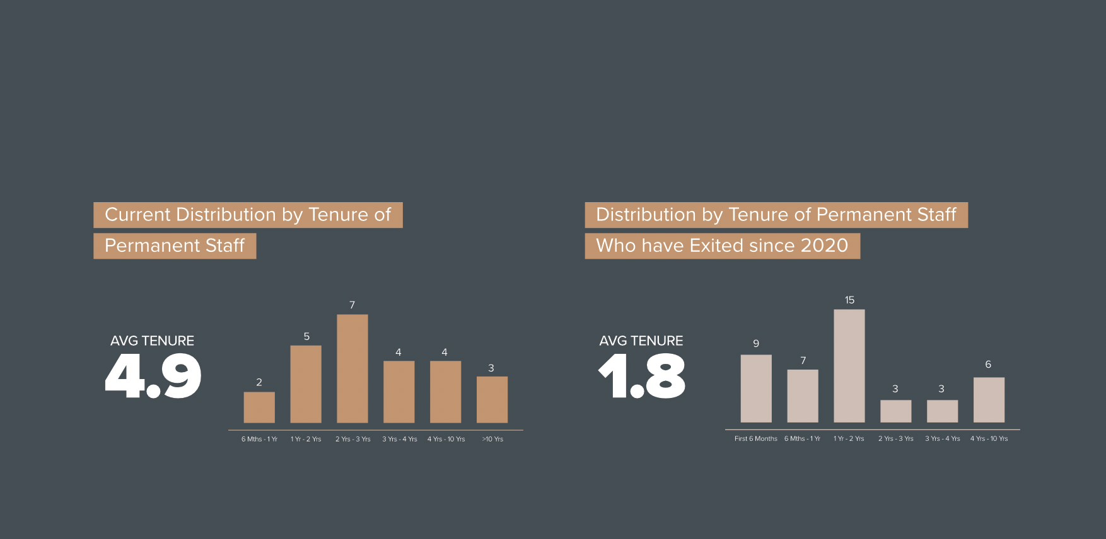
Tracking Our Team's Stability and Growth
Thriving Together: Nurturing Our Team at Nature Canada

Slide 6
Cultivating Growth
and Longevity
Holistic Compensation
Steadfast Support and Confident Growth
4 Pillars:
Holistic Compensation
Steadfast Support and Confident Growth
Culture of Appreciation
Work Life Balance and Flexibility
Culture of Appreciation
Work Life Balance and Flexibility
Thriving Together: Nurturing Our Team at Nature Canada

Slide 7
Holistic Compensation
Roots:
Annual raises to salary to reflect cost-of-living (COLA)
Clarifying salary levels based on roles (Pay Bands)
Annually evaluate the competitiveness of salaries, benchmarking with Charity Village and TREC
Parental leave
Child care assistance in travel policy
Professional development budget
Reduction in short-term employment contracts
RRSP matching
Health & Dental Benefits
Confidential Employee Assistance Program covering counselling and support services
Increase in Mental Health benefits from $500 to $2000
Vacation time, starting at 4 weeks annually
Shoots:
More discussion of how best to support individual professional development
Thriving Together: Nurturing Our Team at Nature Canada

Slide 8
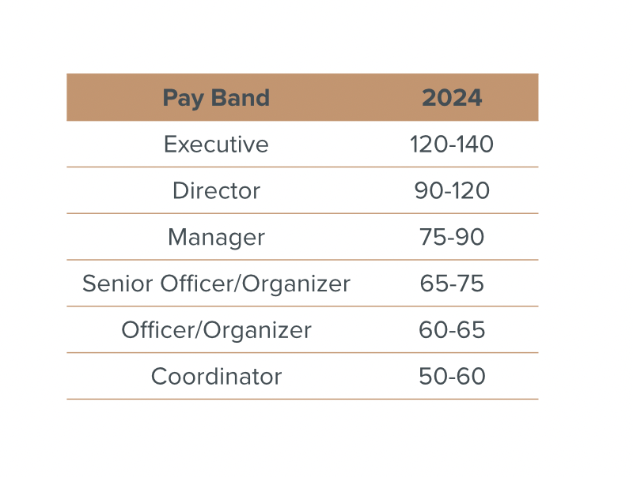
Adoption in the Sector
Current Pay Bands at Nature Canada
Equitable pay takes into account individual differences
Adjusted each year
Thriving Together: Nurturing Our Team at Nature Canada

Slide 9
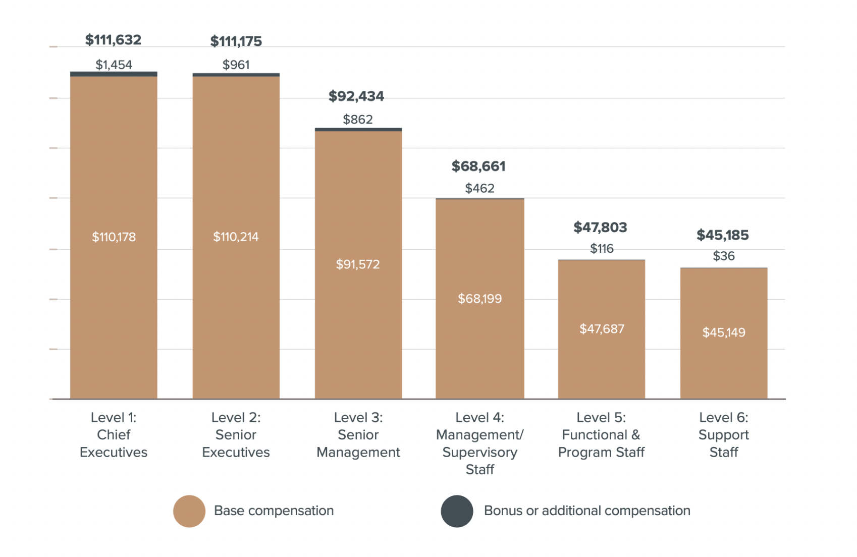
2023 Canadian Nonprofit Sector Salary Benefits Report, Charity Village
ANNUAL CASH COMPENSATION BY LEVEL
Thriving Together: Nurturing Our Team at Nature Canada

Slide 10
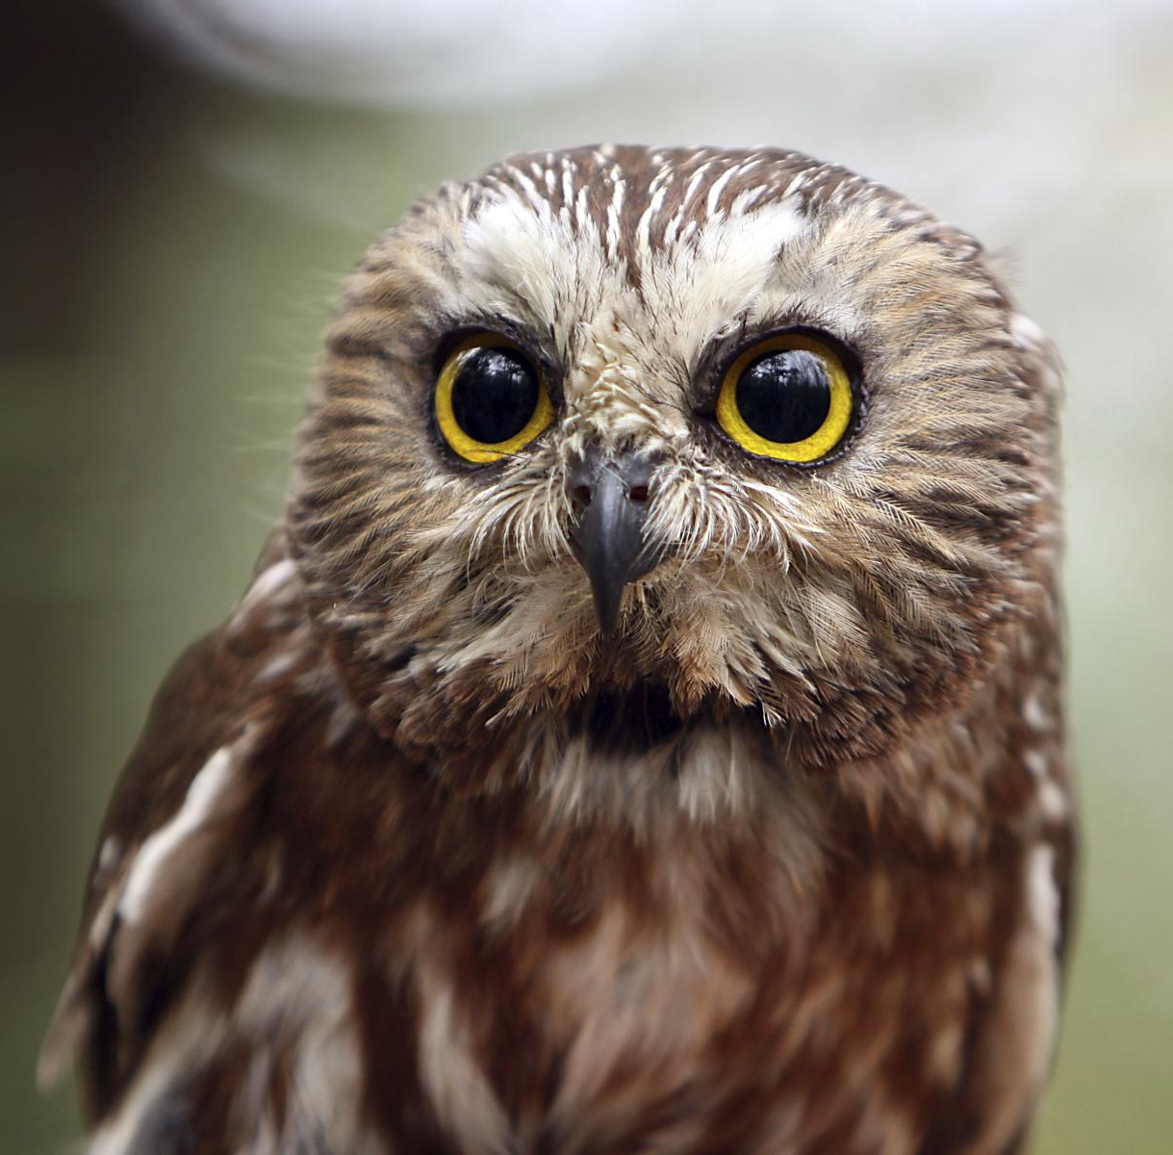
Professional Development
Staff training/retreats
Paid work time for training & learning
Conferences
Mentorships
Thriving Together: Nurturing Our Team at Nature Canada

Slide 11
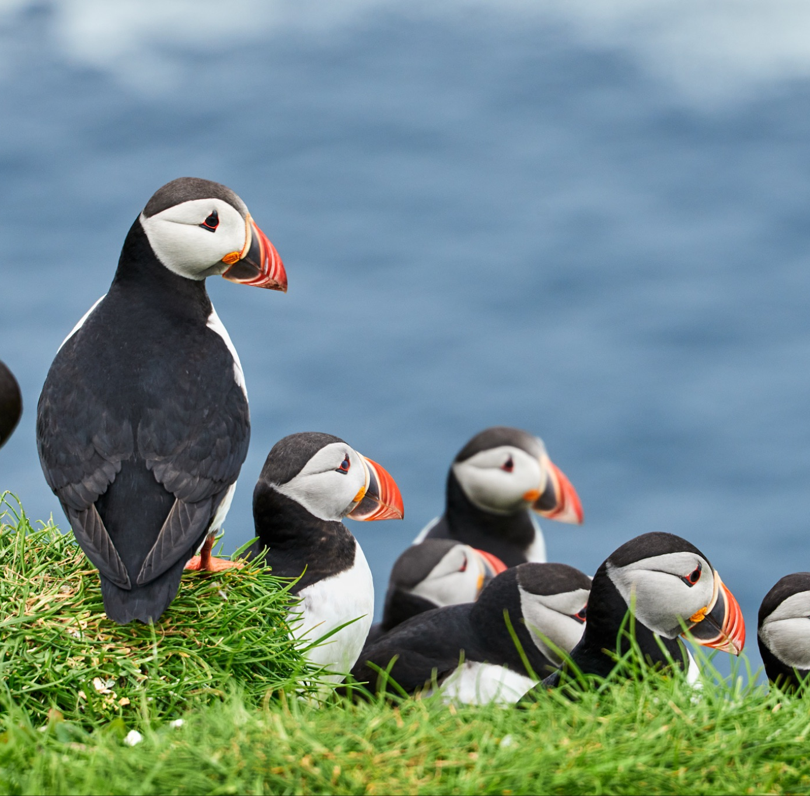
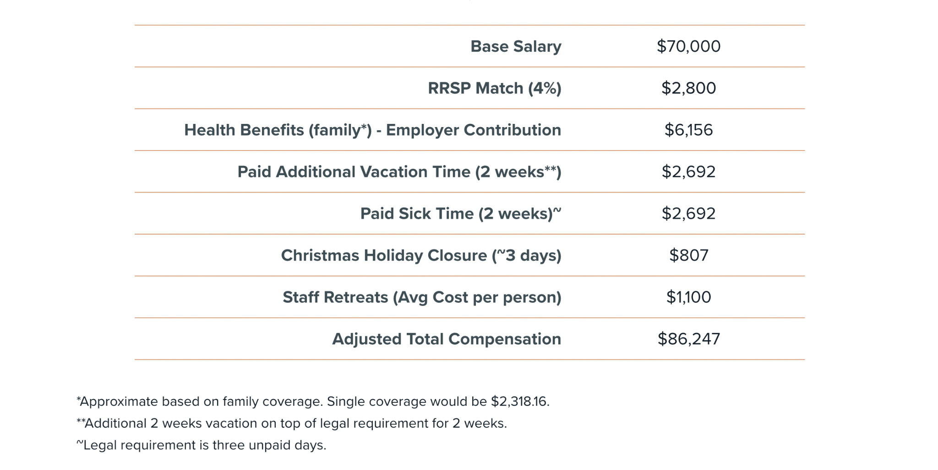
Holistic Compensation - Including Benefits
Thriving Together: Nurturing Our Team at Nature Canada

Slide 12
Steadfast Support and Confident Growth
Roots:
Improvements to Onboarding
Consistent one on ones with Directors
Following best practices for performance evaluation
Regular best practice updates to Personnel Policy
Coaching mindset among Directors
Seeking feedback through Regular annual staff survey and Skip level meetings
Staff retreats
Senior management team retreats
Lunch and Learns
Foster a culture of open feedback and regular check ins
Shoots:
Continue EAR learnings and policy development
Continue journey of Reconciliation
Continue Senior Management Team retreats & trainings
ED’s performance evaluation will seek feedback across the organization
Collaborative work planning to facilitate transparency in management, allowing all to see project timelines, responsibilities, and progress updates
Thriving Together: Nurturing Our Team at Nature Canada

Slide 13
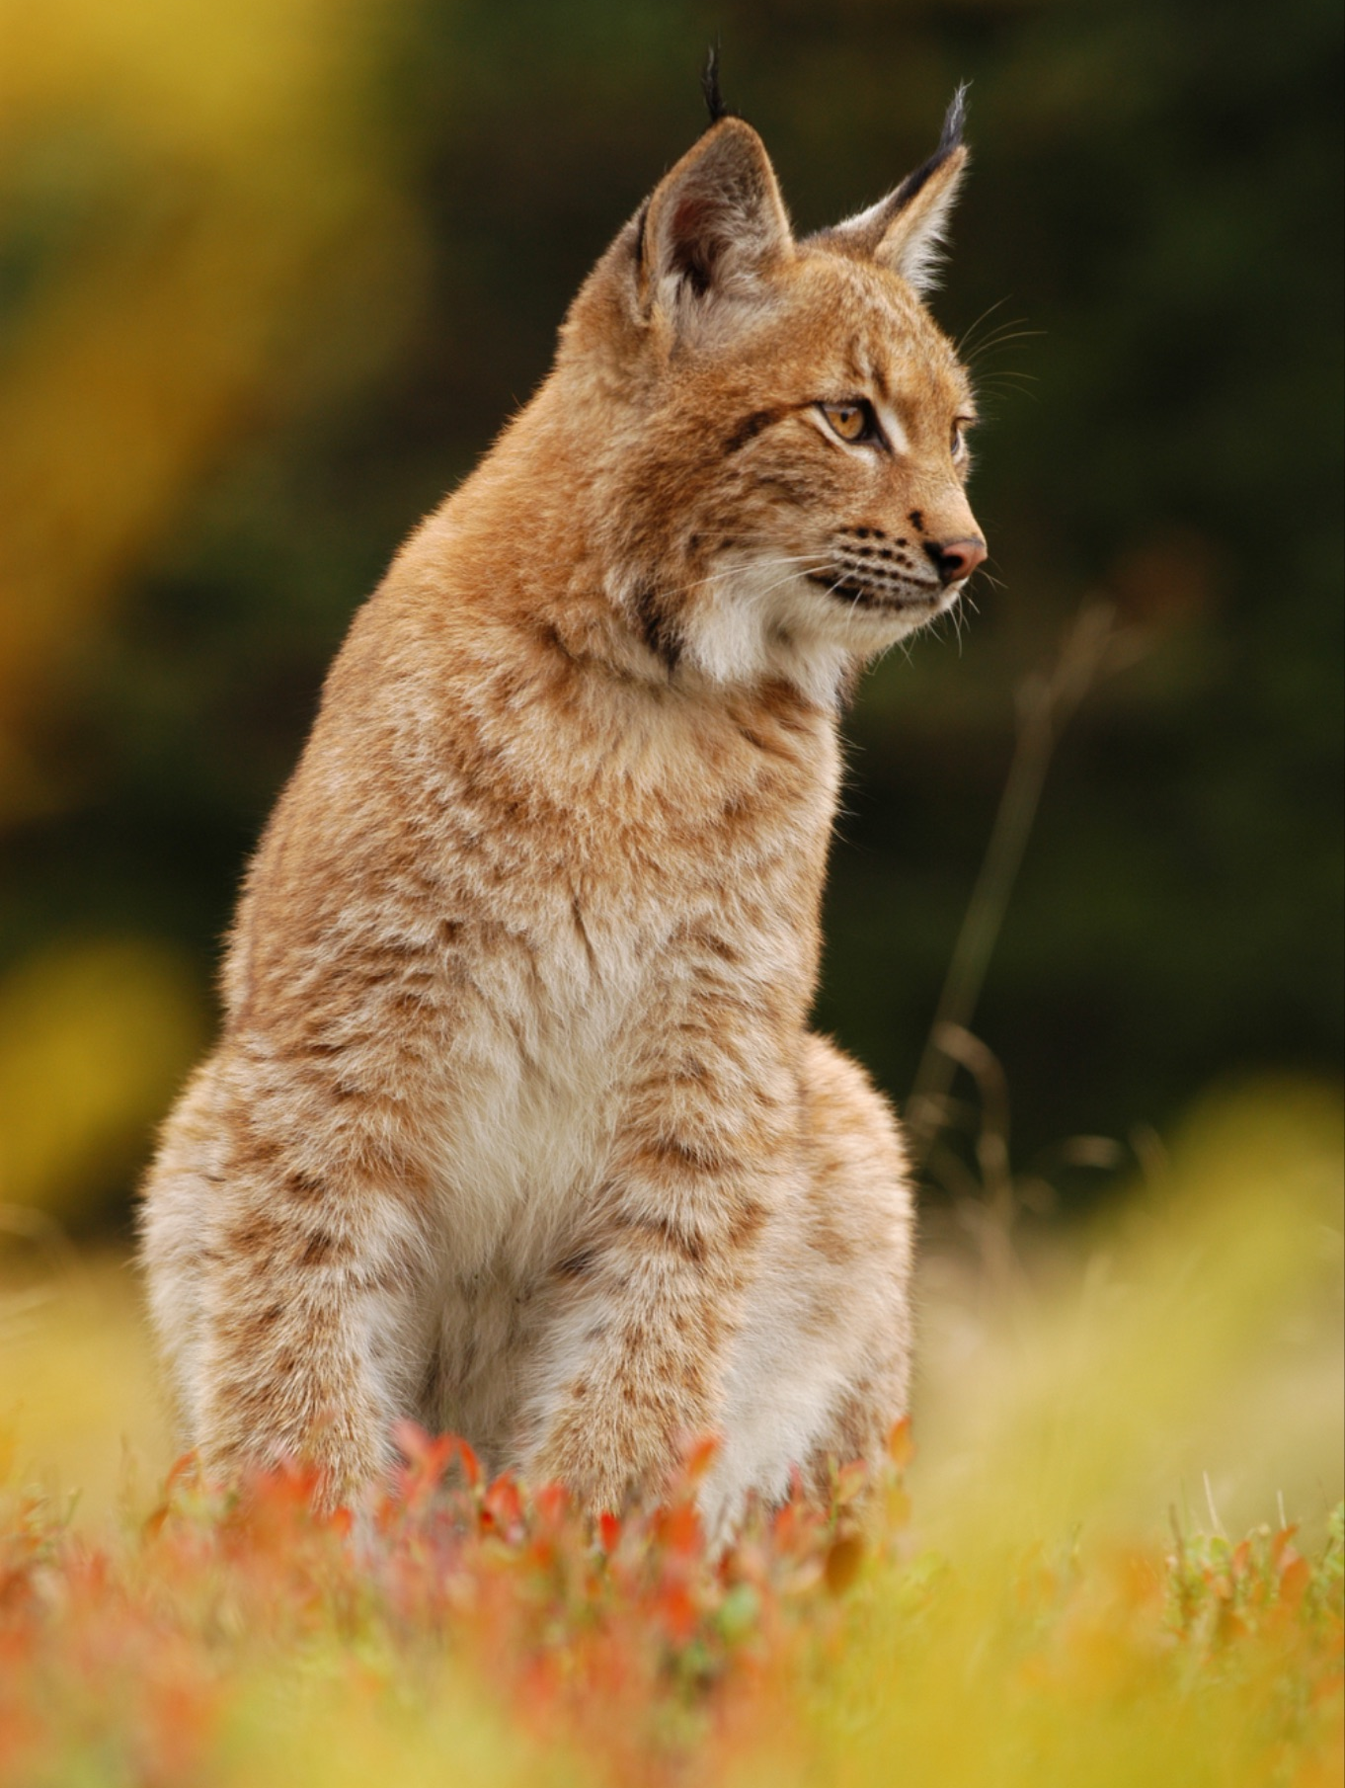
Atmosphere of Appreciation
Roots:
Mandatory EAR training in probation period
Birthday recognition (card & gift card)
Improved onboarding
Shout outs at staff meetings
Anniversary celebrations (15 and 25 years)
Celebration slack channel
Social events: walks in nature, lunches together
Shoots:
Anniversary celebrations (1 and 5 years)
Celebrating non-Christian holidays
Win board
Program team meeting dedicated to celebration
Thriving Together: Nurturing Our Team at Nature Canada

Slide 14
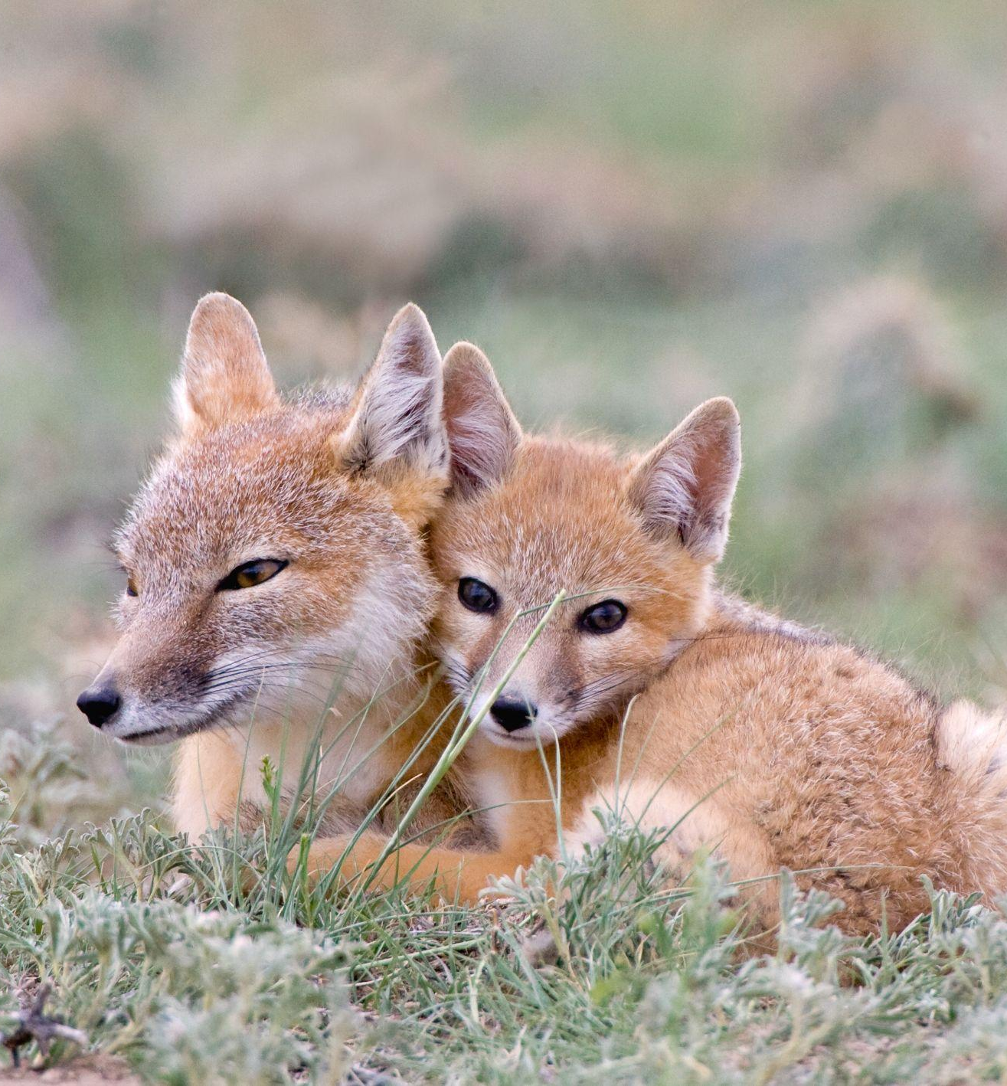
Flexible Work-life Balance
Flexible internal processes
Streamlined meetings
Efficient communication channels
Supportive Leadership
Clear role expectations
Equitable treatment
Open communication
Managerial support
Achievable Workloads
Balanced task assignments
Realistic deadlines.
Nurturing Culture
Encouragement of innovation and collaboration
Fostering a culture of psychological safety and open communication
Thriving Together: Nurturing Our Team at Nature Canada

Slide 15
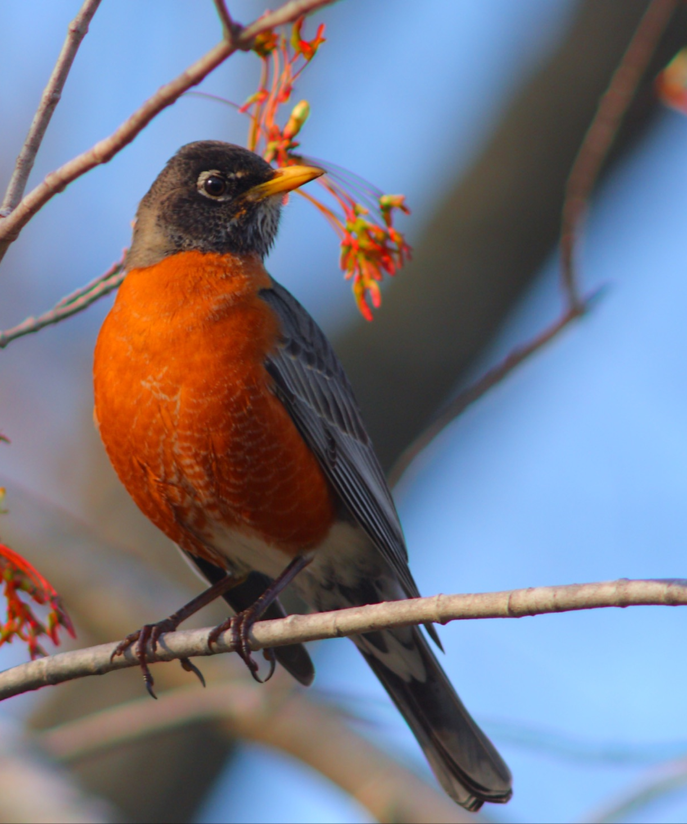
Flexible Work-life balance
Roots:
Finding efficiencies with meeting clean ups
Using technology for better coordination and transparency: Slack, Asana
Clarifying priority work using the Ecocycle
Hybrid work policy and flexibility in daily hours
Annual training on Personnel Policy
Travel Policy per diems on par with government
Corporate credit cards for travel to reduce burden of paying up front
Clarity around roles and responsibilities
Campaign roll out plans
Individual Work Plans
Shoots:
Training in psychological safety
Change in vacation policy
Thriving Together: Nurturing Our Team at Nature Canada

Slide 16
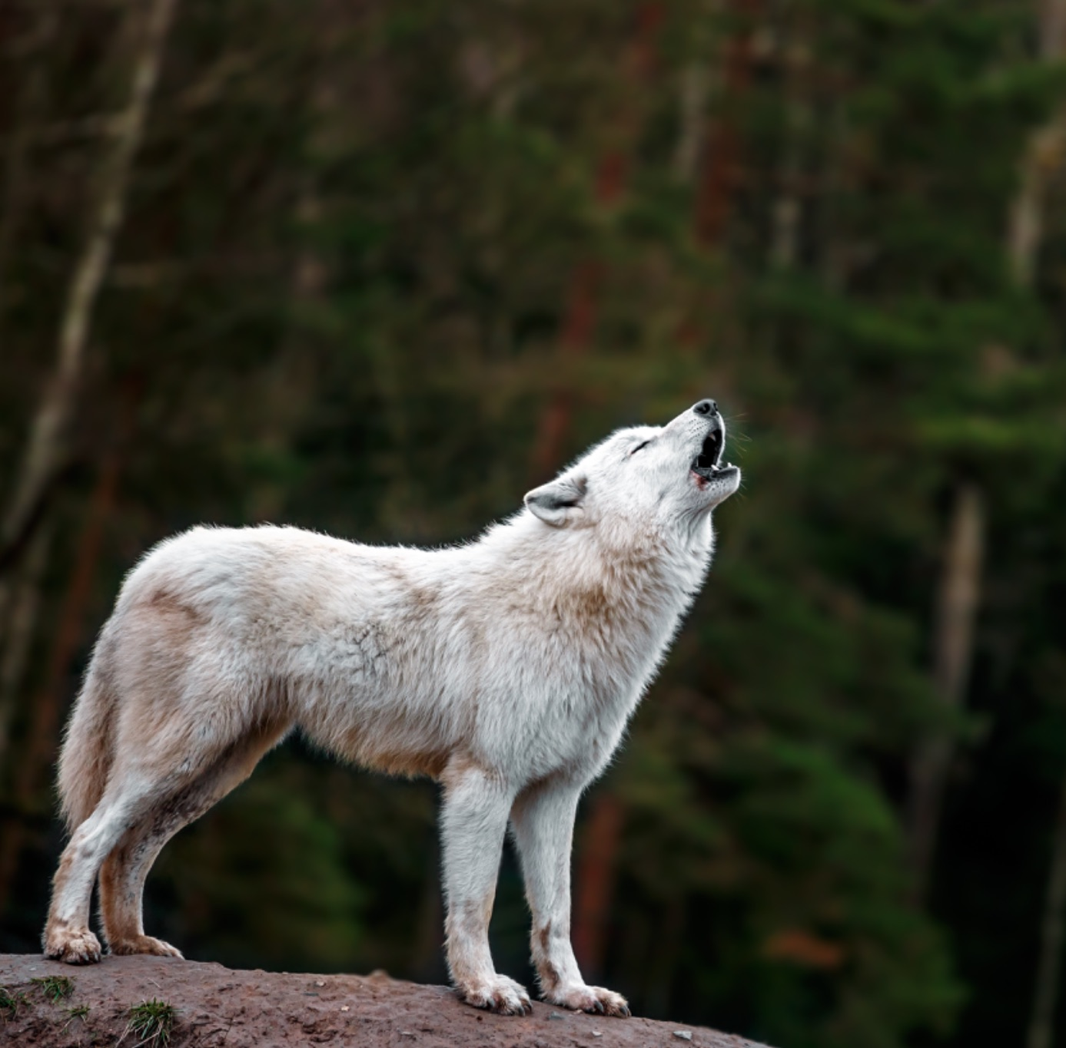
Big news
OWN YOUR FRIDAY
Nature Canada's Nourishing Work Week
Thriving Together: Nurturing Our Team at Nature Canada

