Slide 1
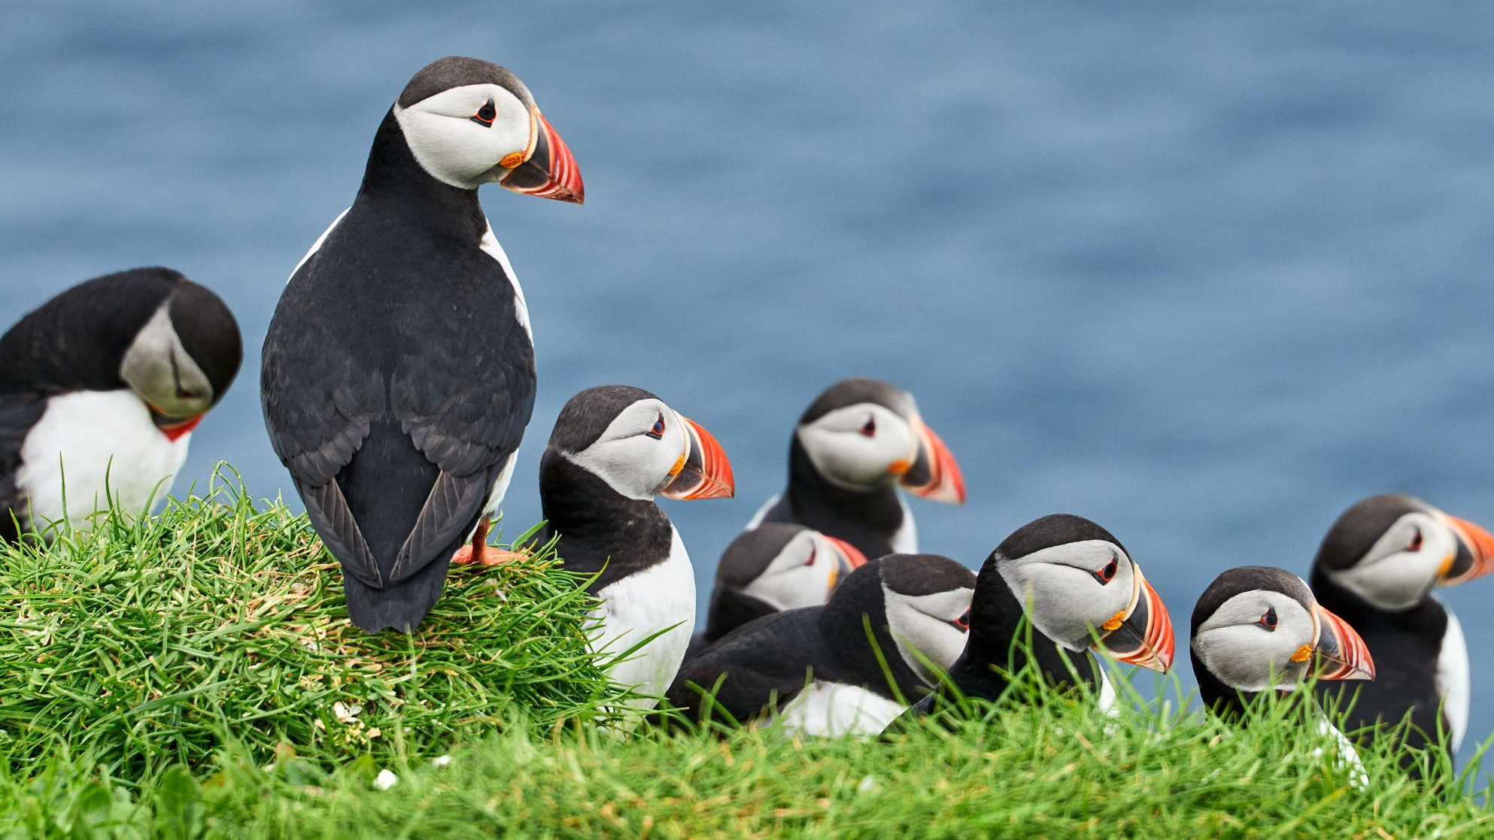
OWN YOUR FRIDAY
Nature Canada's Nourishing Work Week

Slide 2
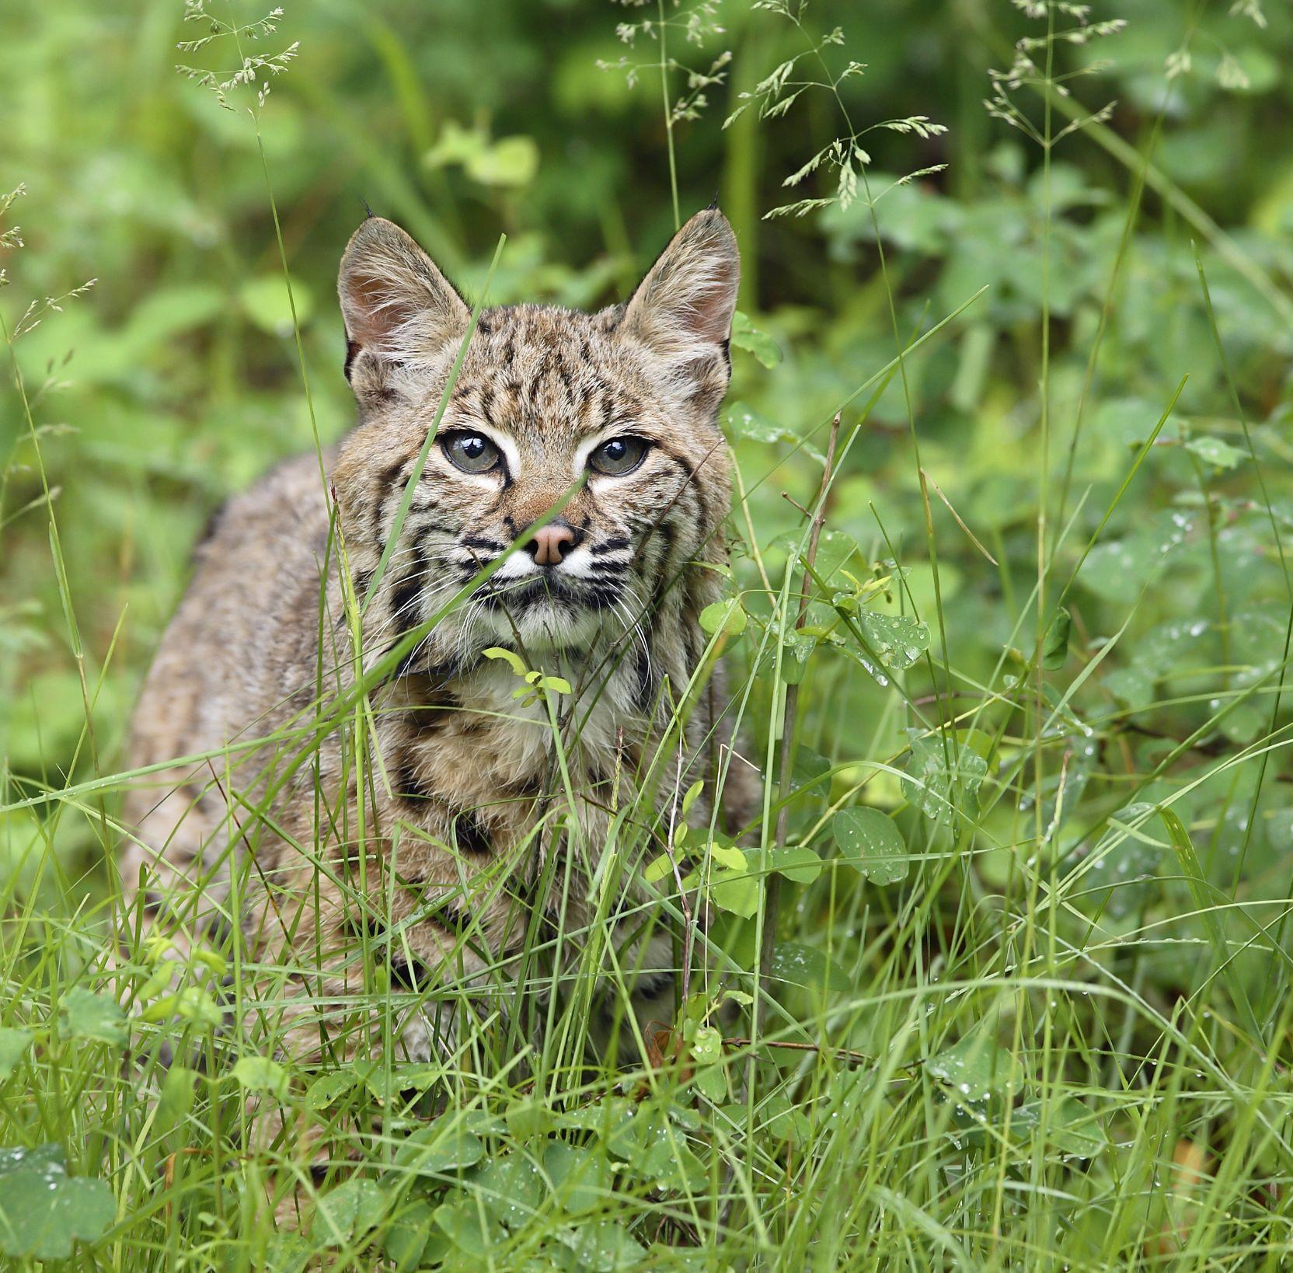
People First
We people as the source of our success
Protecting threatened species and ecosystems is hard!
Recognizing challenges: burnout, poor work-life balance, eco-anxiety
Learnings from remote and hybrid work during COVID-19
Own your Friday: Nature Canada's Nourishing Work Week

Slide 3
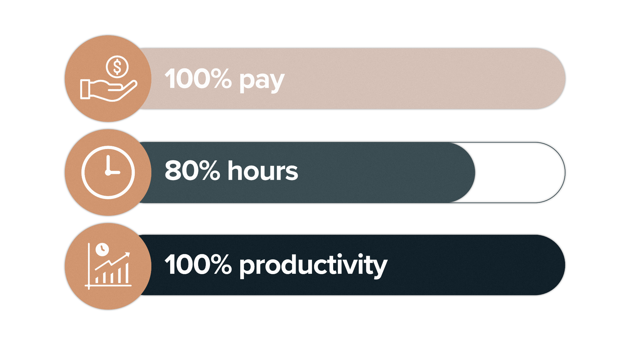
Pilot Program
Pilot a four-day work week starting in July until January 2025
100-80-100 model: 100% pay, 80% hours, 100% productivity
Own your Friday: Nature Canada's Nourishing Work Week

Slide 4
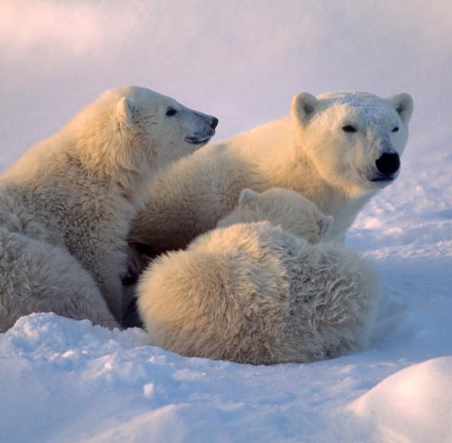
Objectives
Reduce burnout and support work-life balance
Attract and retain high-performing staff
Maintain productivity and impact
Own your Friday: Nature Canada's Nourishing Work Week

Slide 5
Adoption in the Sector
17%
Already there:
of charities in Canada have adopted four-day work weeks
Own your Friday: Nature Canada's Nourishing Work Week

Slide 6
Groundwork
We have already undertaken improvements in work practices:
Slack, Asana
Hybrid work policy
Meeting optimization
Campaign roll out plans
Workplans
We are making it a priority to focus on the most impactful work, rather than all the possible work.
Own your Friday: Nature Canada's Nourishing Work Week

Slide 7
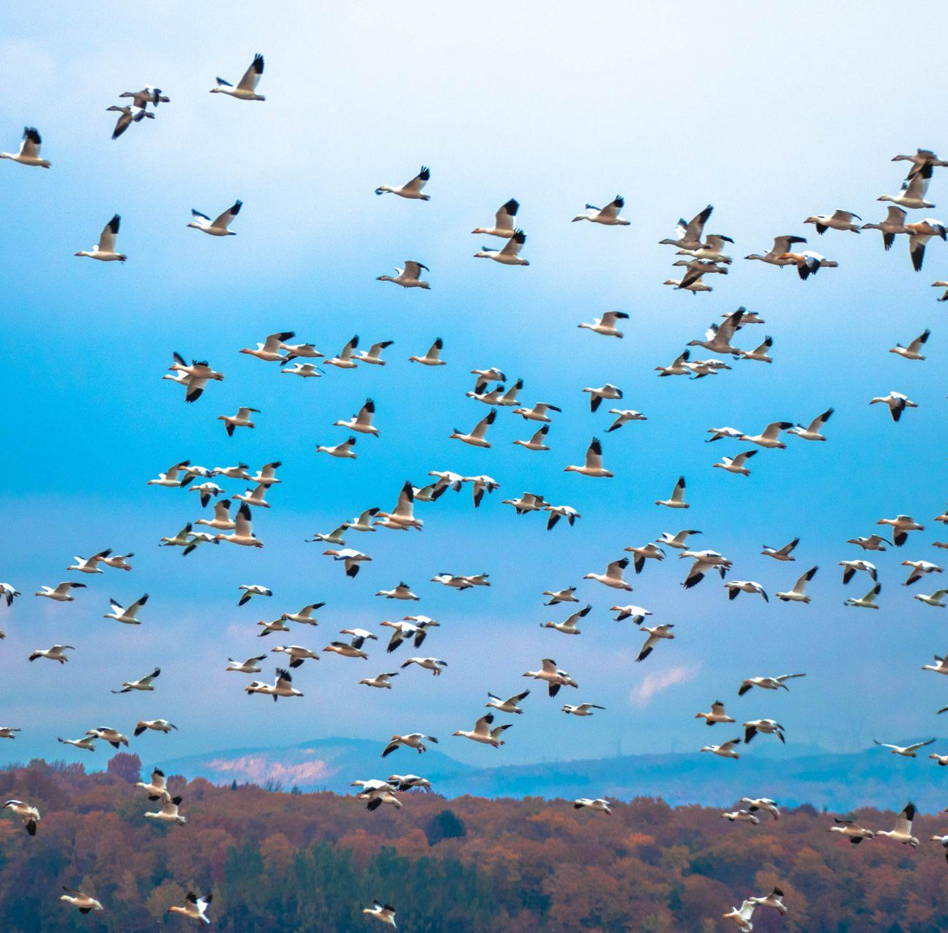
Benefits
Increased employee well-being and reduction of burnout
Higher job satisfaction and retention
Equity in the workplace, especially for caregivers
Health benefits, creativity, and reflection time
Own your Friday: Nature Canada's Nourishing Work Week

Slide 8
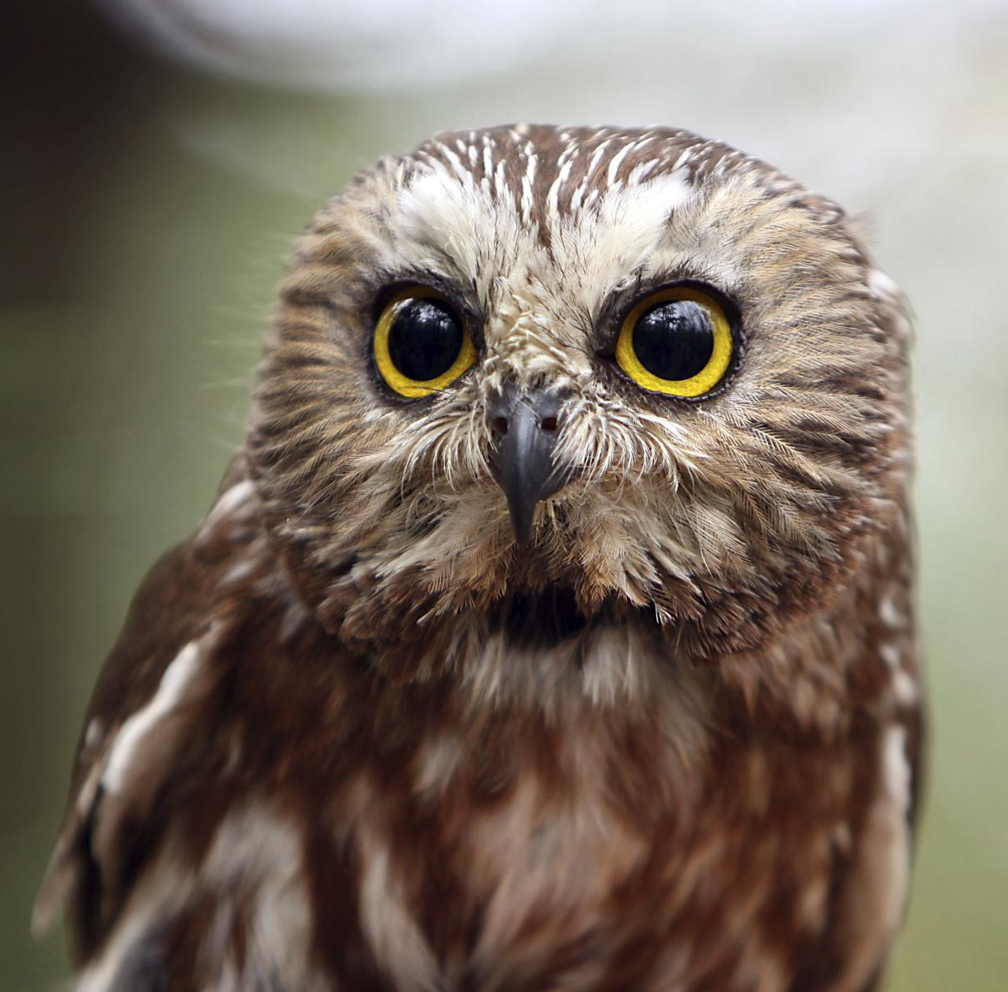
Challenges
Managing workload within fewer hours
Handling external meetings
Planning for busy periods and capacity management
Own your Friday: Nature Canada's Nourishing Work Week

Slide 9
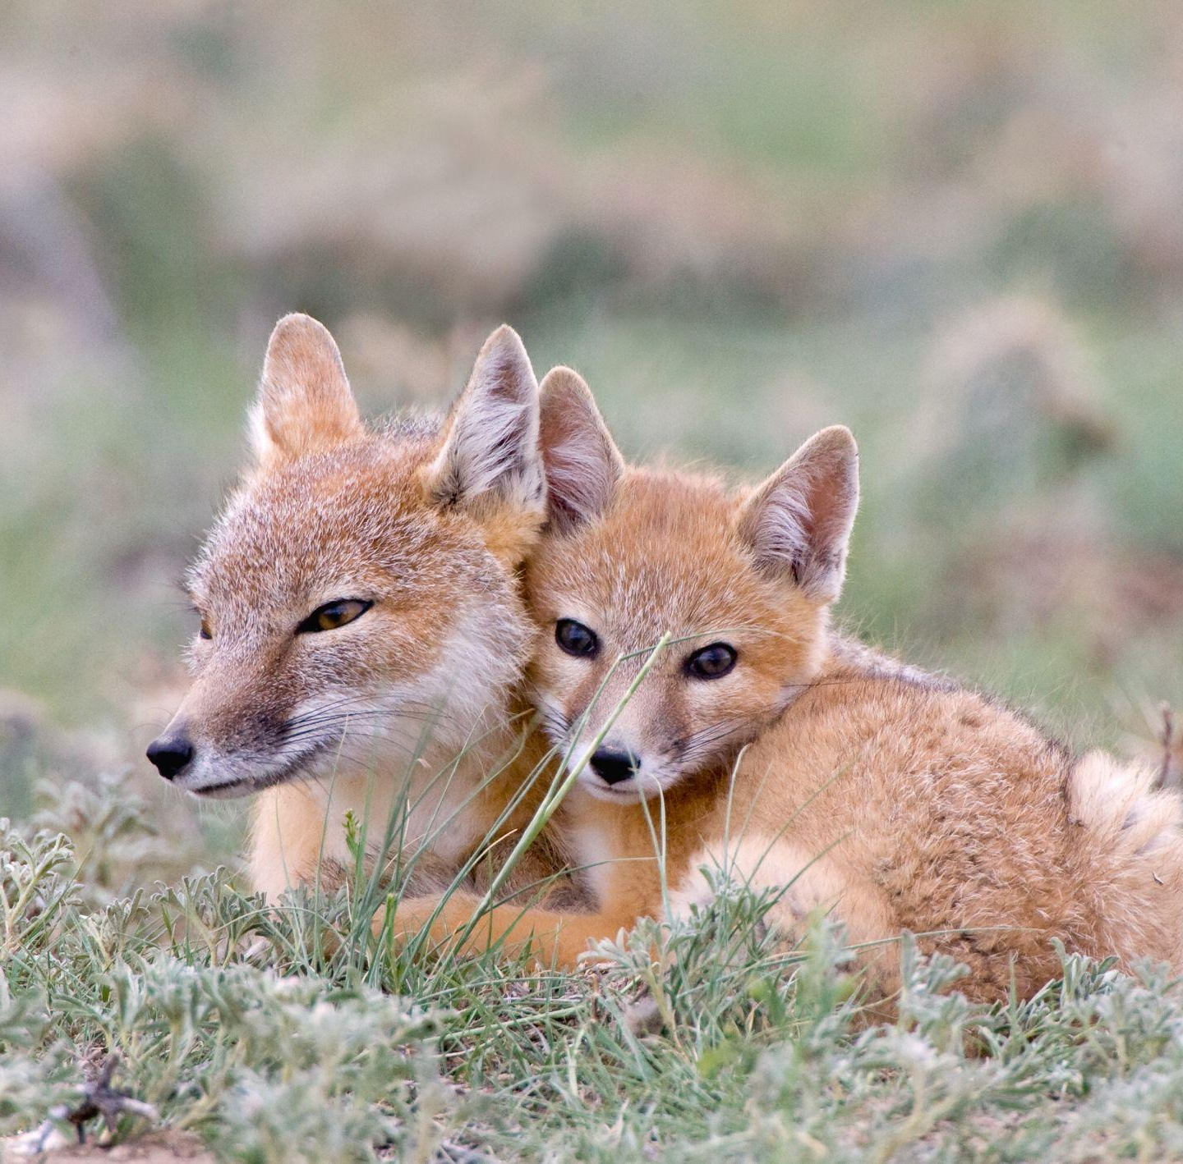
Pilot
Determine whether this model is right for Nature Canada
Measuring our productivity
Evaluation, feedback, adjustments
Own your Friday: Nature Canada's Nourishing Work Week

Slide 10
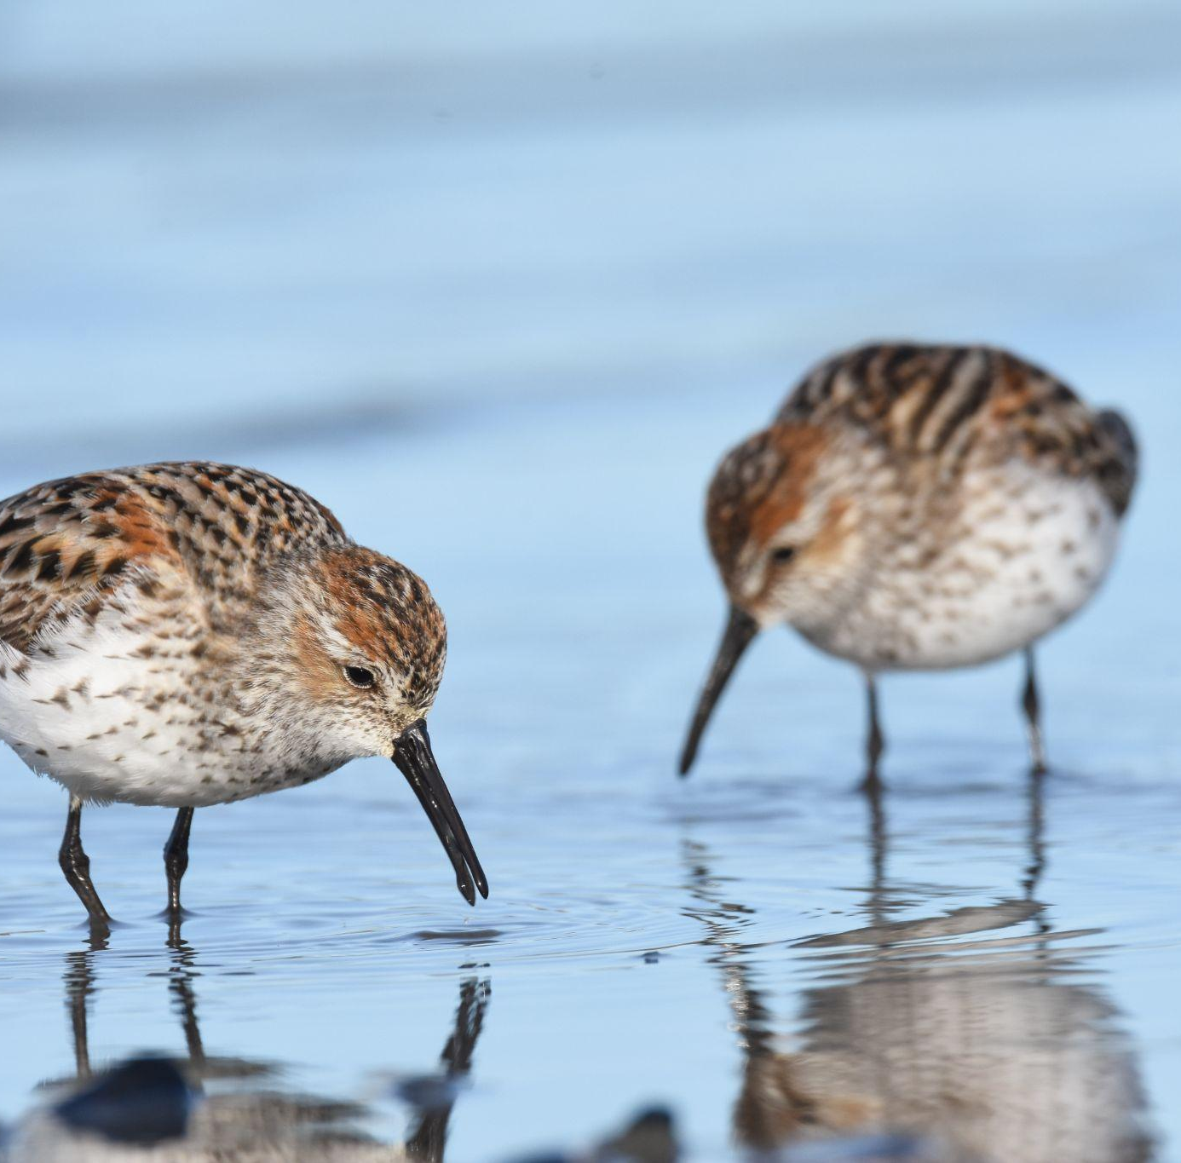
How it Can Work
Prioritize
Efficiency strategies: reduction of meeting times, Asana
Realistic timelines
Outcome management for Impact
Own your Friday: Nature Canada's Nourishing Work Week

Slide 11
Tips
Plan your Monday before the end of day on Thursday
Schedule time for daily/weekly workload planning
Block time for focus time
Use Google calendar to block time
Use Asana to manage tasks
Continue to reduce and shorten meetings
Answer email in batches, rather than react to them as they arrive in your inbox
Own your Friday: Nature Canada's Nourishing Work Week

Slide 12
Next Steps
May and June to get ready!
May 9 - Campaign Plan Roll Out Doc Day
May 17 - Meeting clean up - training and implementation
May 21 - Asana training
May 28 - Retreat on psychological safety
June 4 - Training on measurement of productivity
June 14 - More Asana training and implementation
June 25 - Check in
Feedback gathering continuously
Own your Friday: Nature Canada's Nourishing Work Week

Slide 13
Own Your Friday
Work only if you want to
Freedom to choose non-work activities
Personal appointments
Resting
Volunteering in the community
Household chores
Spending time in nature
Own your Friday: Nature Canada's Nourishing Work Week

